Slide 1

Educational Management System
TEAM ID: 725608
PREPARED BY : SANGANI PRATHAMA NARESHBHAI
SUBMITTED TO : PROF. ANKITA SHAH
INTERNSHIP AT : FORTHTECH
HOD CE : DR. DUSHYANTSINH RATHOD

Slide 2
OUTLINE
1. Introduction
2. Abstract
3. Objectives
4. Tools & Technologies
5. Flowchart
6. Implementation
7. Limitations
8. Future Enhancements
9. Conclusion

Slide 3
Company Introduction
Industrial Design, Robotics , Electronic, and Software Solutions,
we drive innovation to reshape industries.
Software Development Excellence From AI-driven applications to enterprise solutions,craft intelligent, scalable, and
high-performance software that powers the future.
Innovate. Transform. Thrive. Explore our projects and join us in building a future where technology and humanity evolve
together!

Slide 4
Introduction
The Educational Management System is a digital solution designed to streamline academic administration by managing student records, fee payments, report generation, and faculty-student communication. Traditional manual processes are often time-consuming and prone to errors, making digital management essential for efficiency and accuracy.
This system provides role-based access control, where Admins manage faculty, Faculty oversee student records, and Students can access their profiles, report cards, and pay fees using Razorpay Payment Gateway. Secure authentication is implemented using Google Email login, ensuring students receive their credentials upon registration.

Slide 5
Abstract
Student Management System developed using Spring Boot and MySQL. The system is designed with role-based access control, featuring two primary roles: Student and Faculty. The Admin manages faculty members, while faculty members oversee student records. The Admin panel is connected with microservices for enhanced scalability and modularity. Upon registration, students receive their login credentials via Google Email. The system provides students with secure authentication, profile management, report card access, and a fee payment feature using Razorpay Payment Gateway. Faculty members can add, edit, delete, search, and view student details, ensuring streamlined academic administration. To enhance communication, the system includes real-time private and group chat functionality using WebSockets. Security is a key focus, with JWT authentication ensuring protected access and email-based password recovery for a smooth user experience. Additionally, the system is deployed on Railway, making it accessible and scalable

Slide 6
Objectives
Develop a structured student management platform.
Provide secure authentication and role-based access control.
Enable faculty to manage student records efficiently.
Allow students to access academic reports and make payments.
Implement scalability using microservices.

Slide 7
Tools & Technologies
Backend: Spring Boot, Java, MySQL
Frontend: HTML, Tailwind CSS, JavaScript
Security: JWT Authentication (future), Google Email integration
Communication: WebSockets , Microservices
Payment: Razorpay
Deployment: Railway

Slide 8
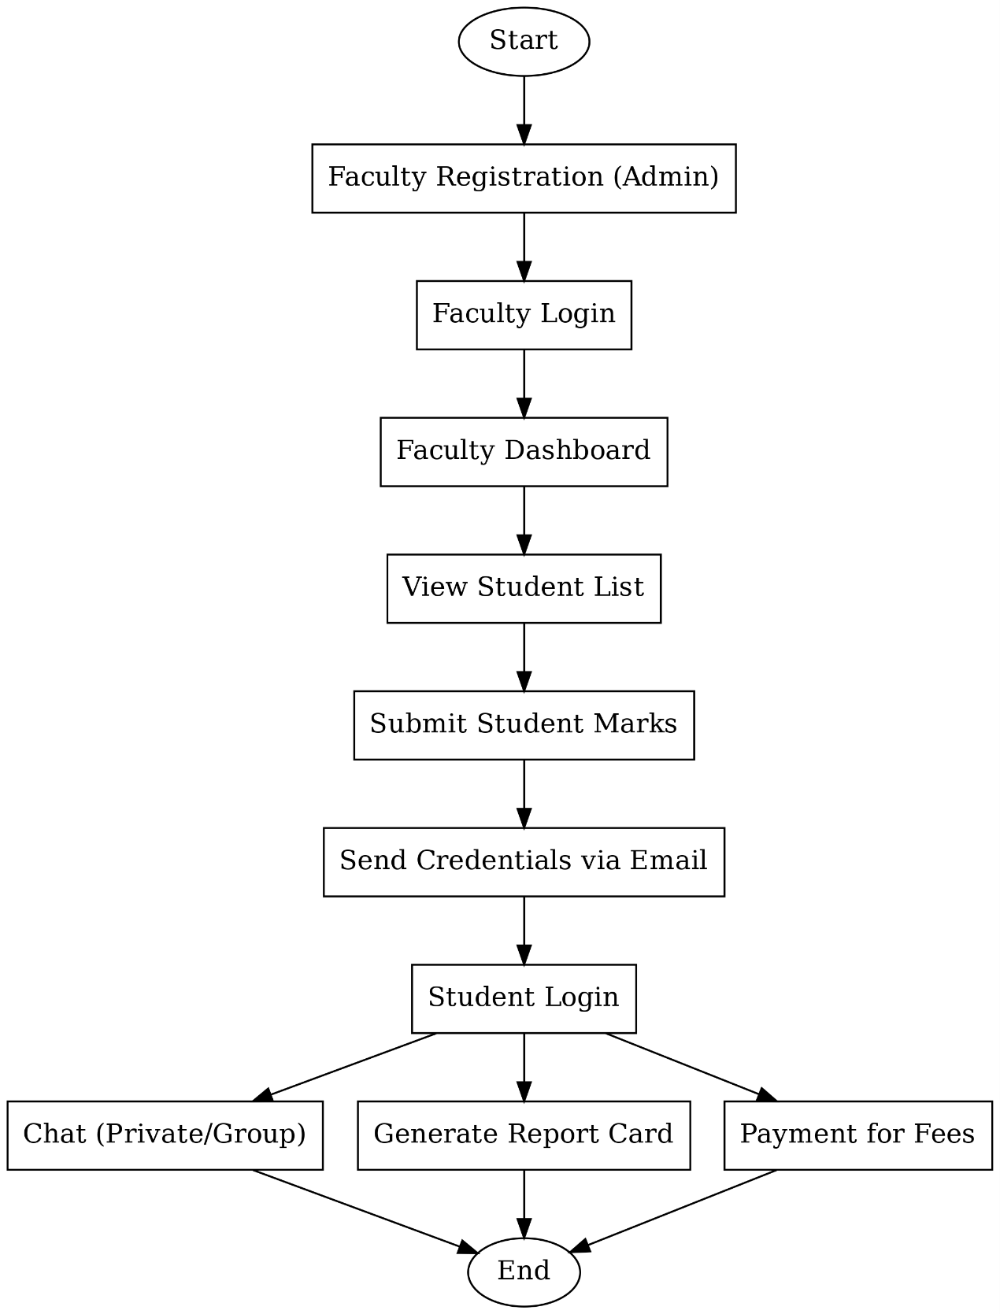
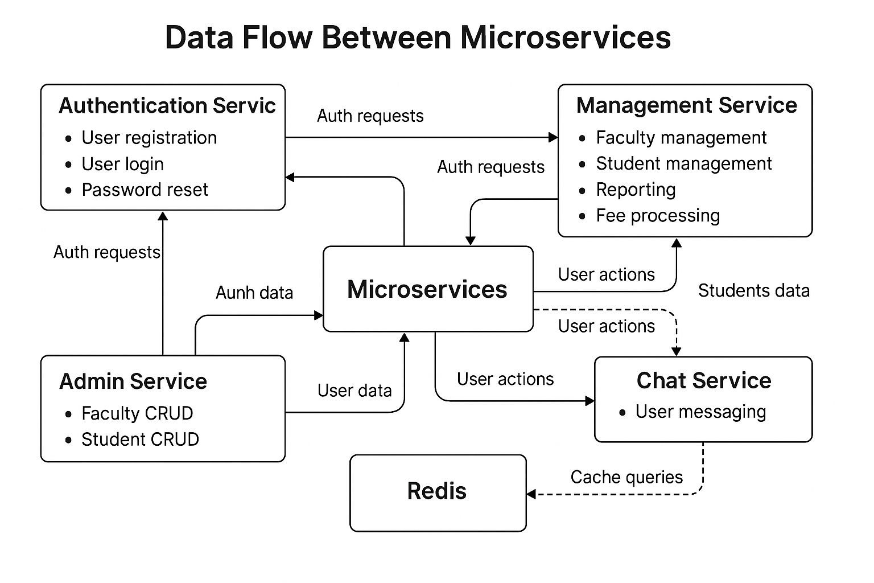
Flowchart

Slide 9
Implementation
User Registration: Admin adds faculty, faculty adds students.
Login & Authentication: Secure login with Google Email, future JWT.
Student Management: Faculty can add, edit, delete, and search students.
Profile & Report Card: Students can view personal details and academic progress.
Admin Panel : Manage Student Faculty And Inquiries , that connect with Microservices.
Data Storage: MySQL database with relational mapping.

Slide 10
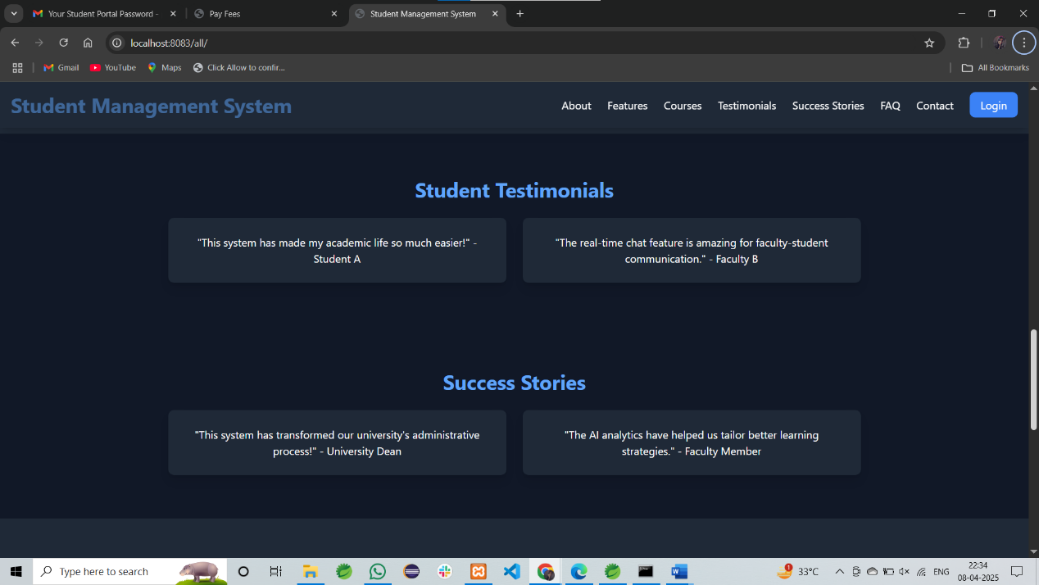
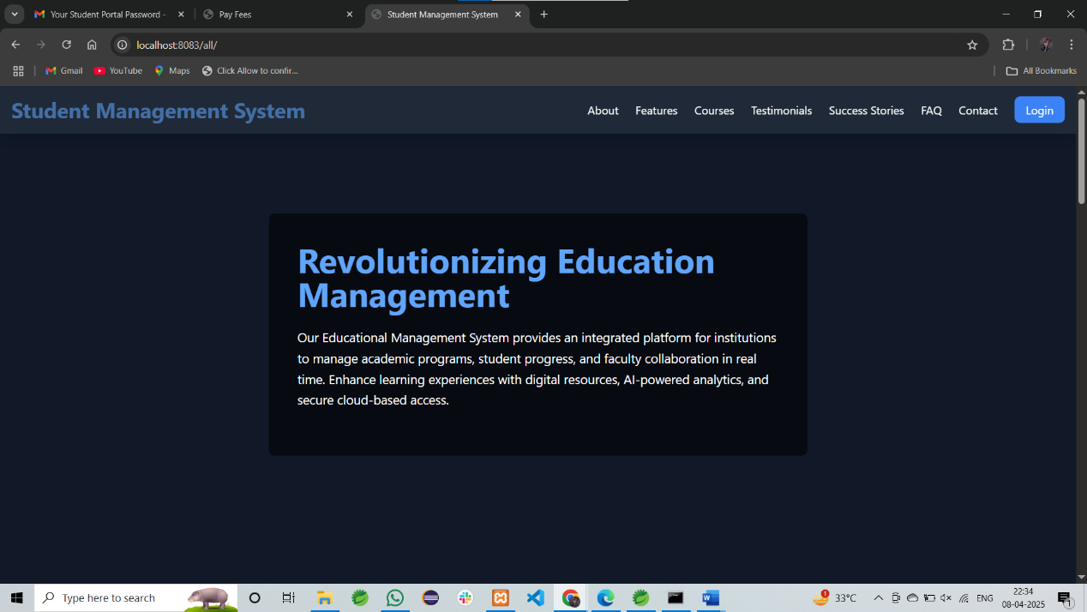
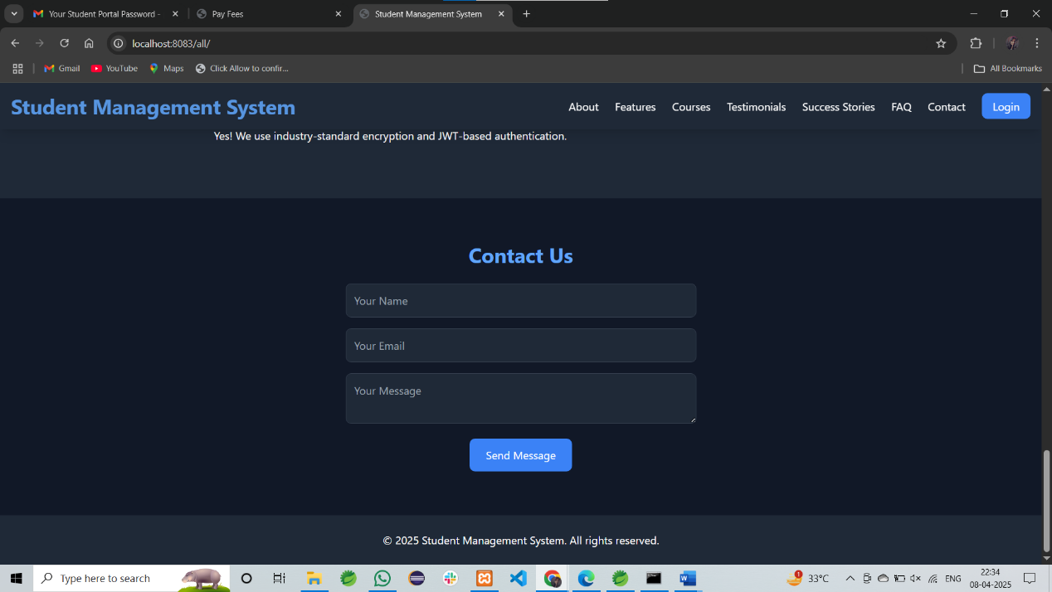
Home Page

Slide 11
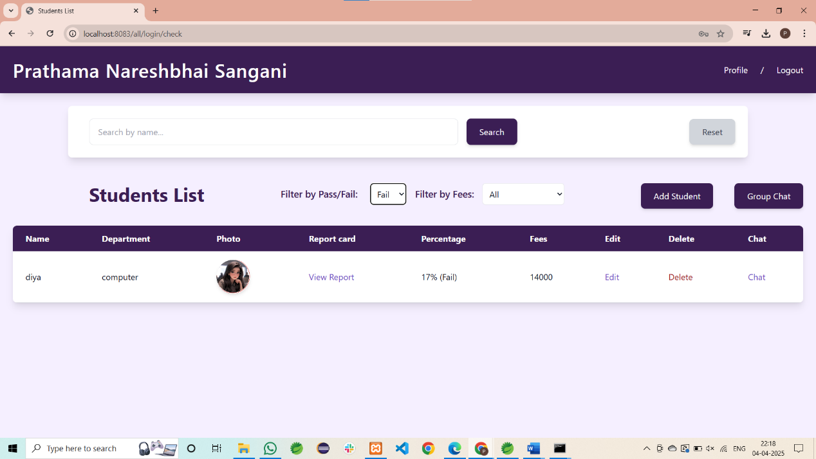
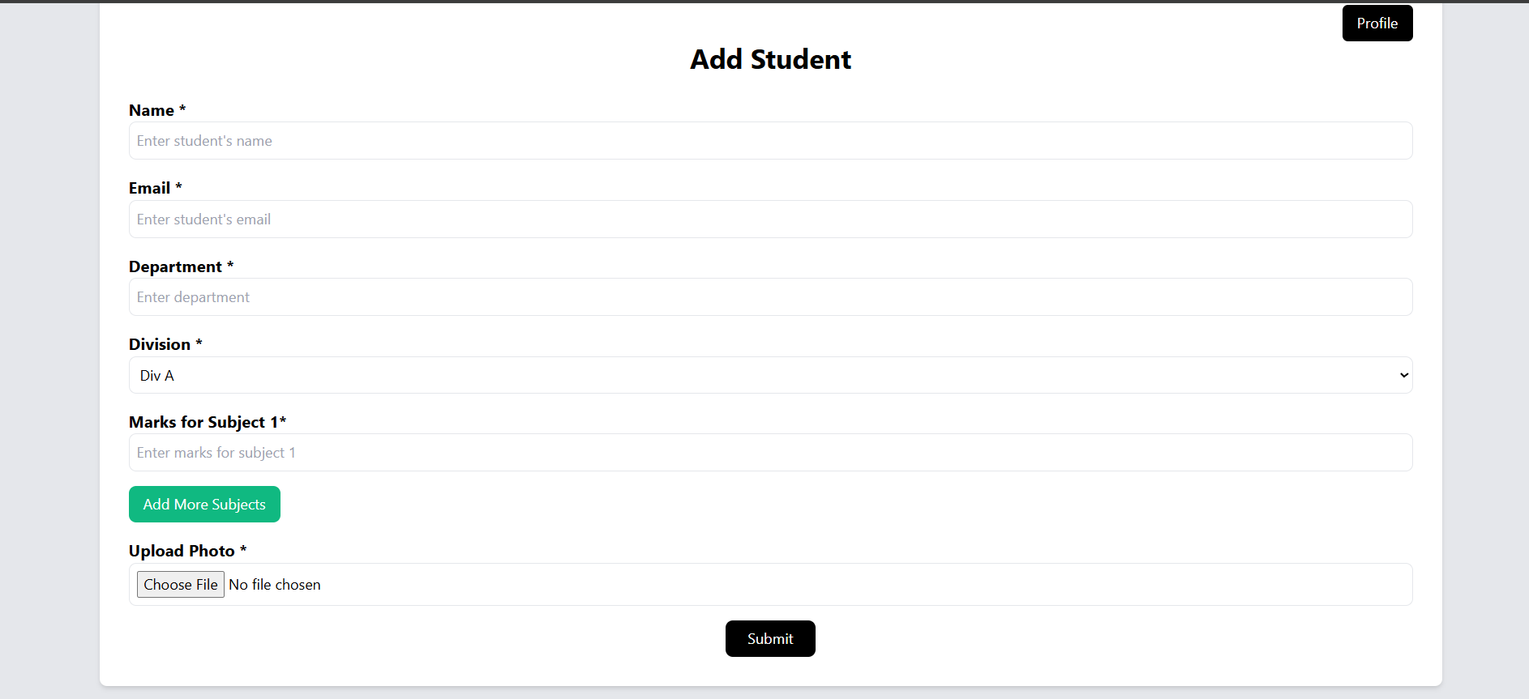
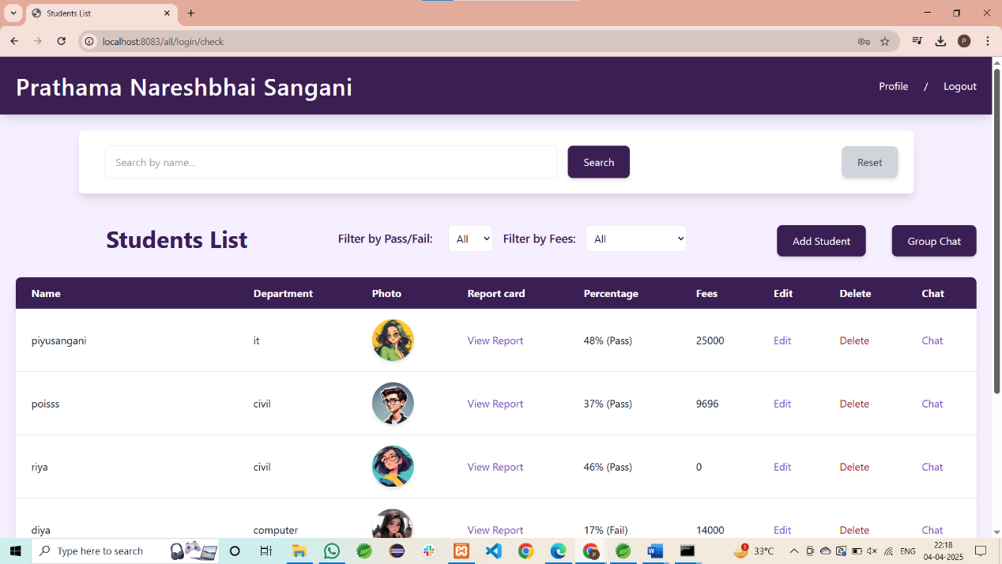
Faculty Page

Slide 12
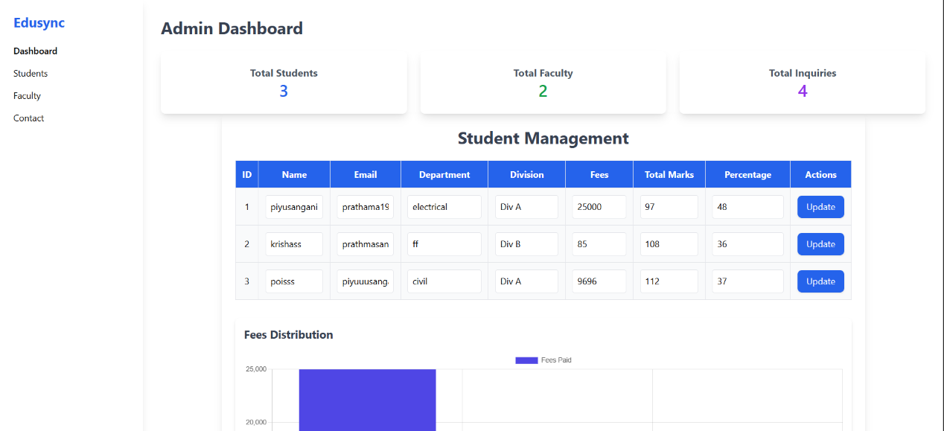
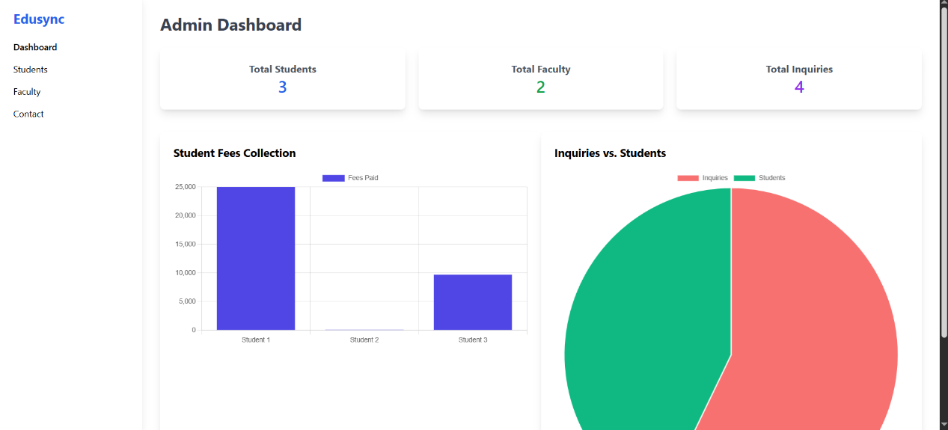
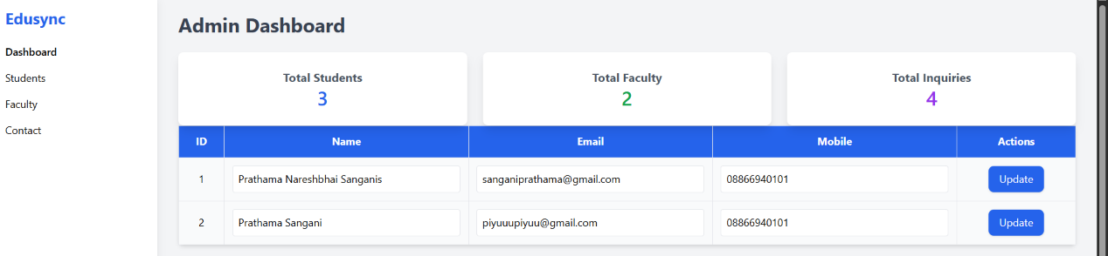
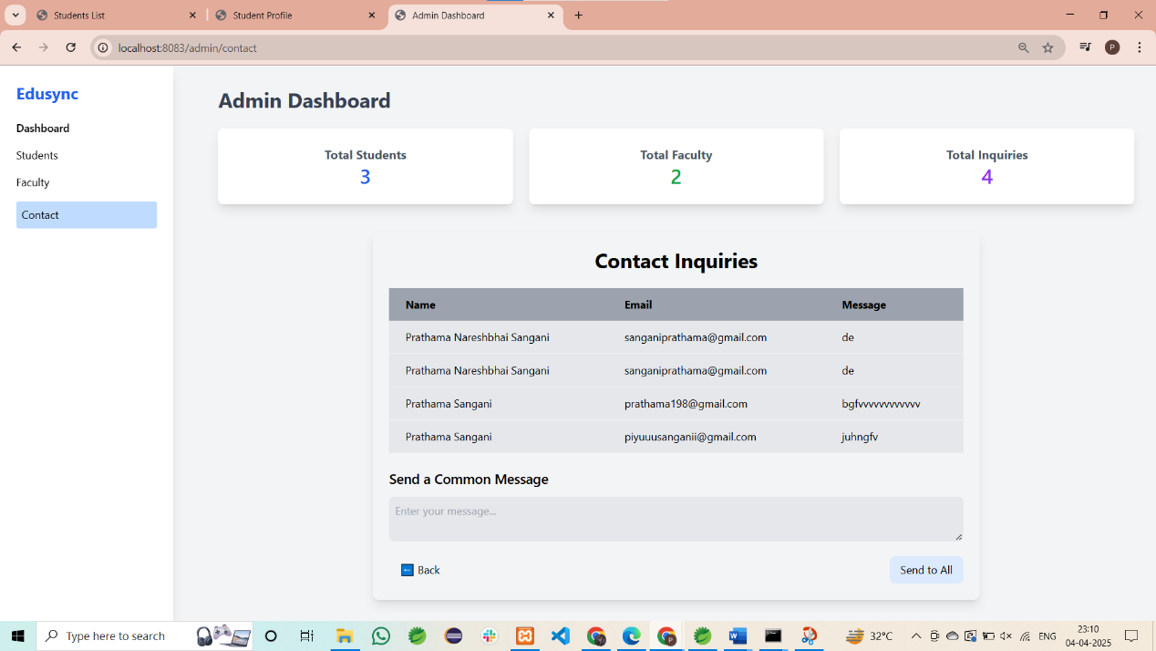
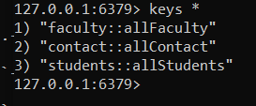
ADMIN PAGE

Slide 13
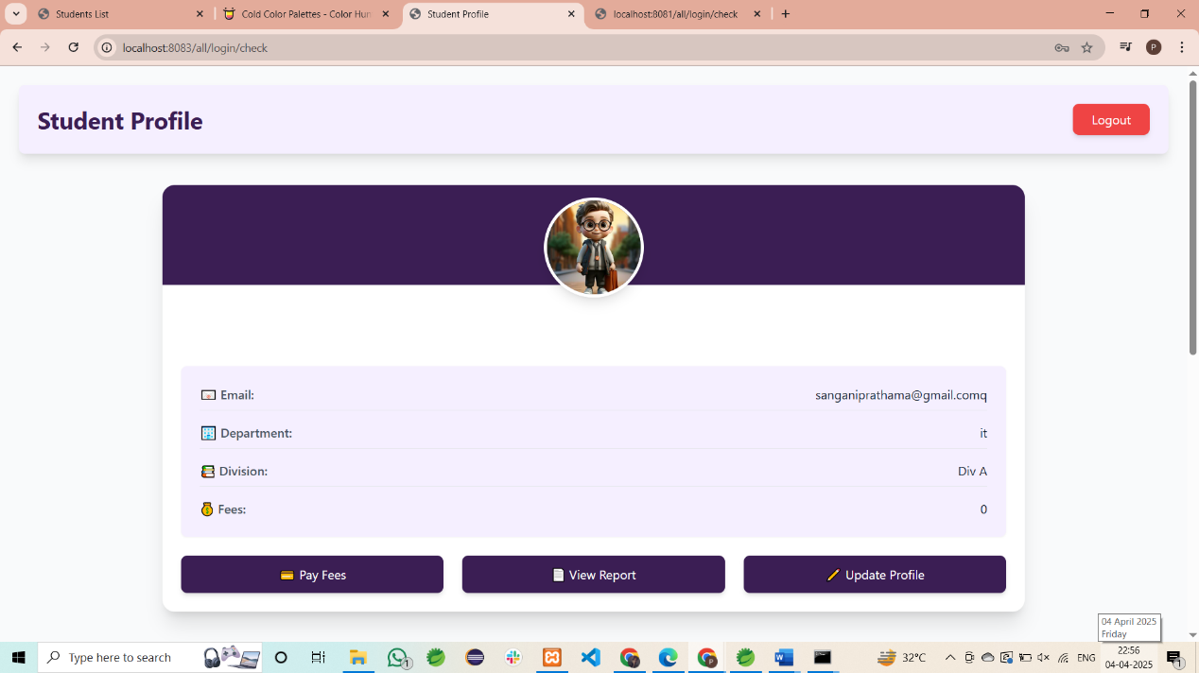
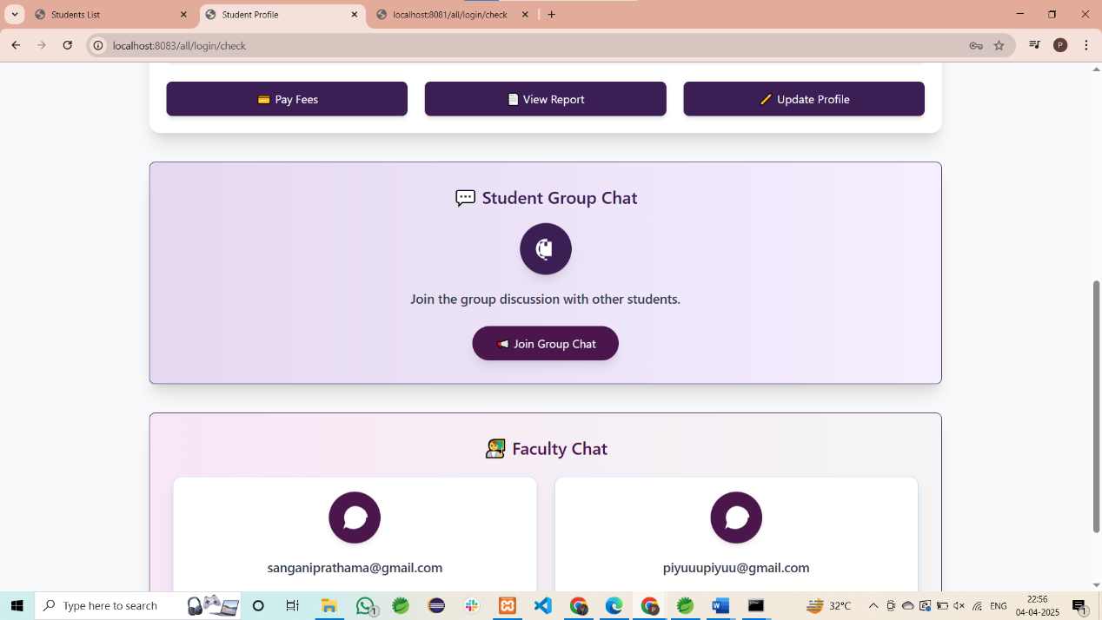
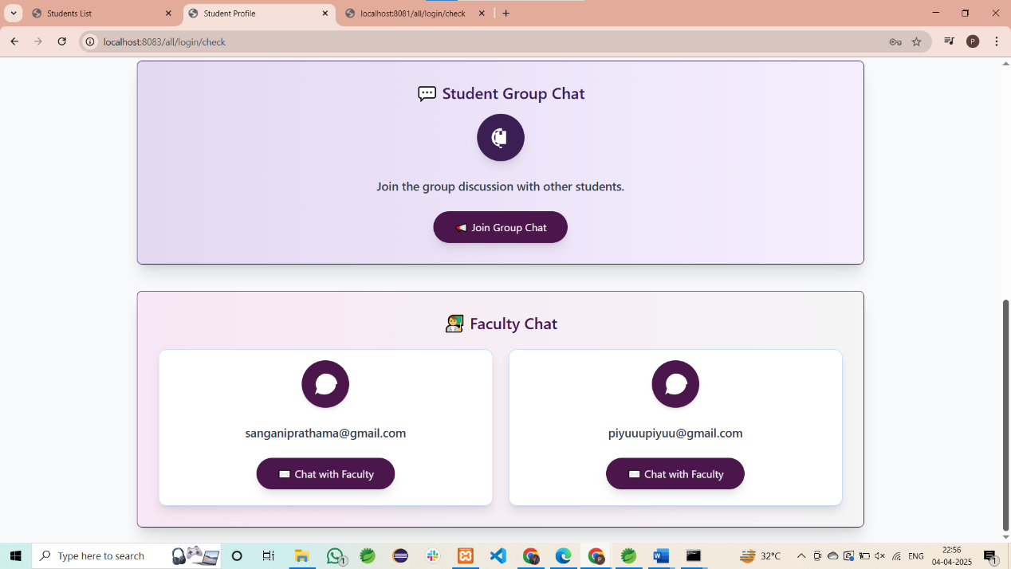
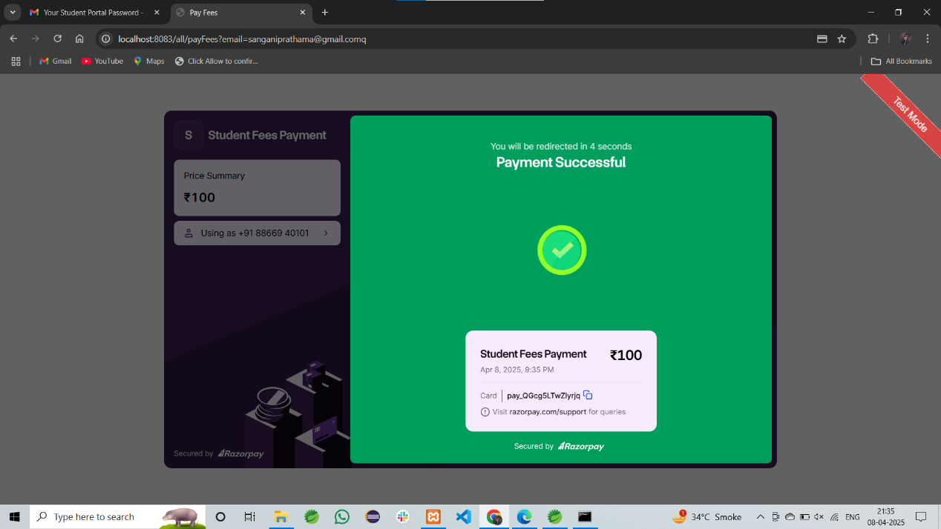
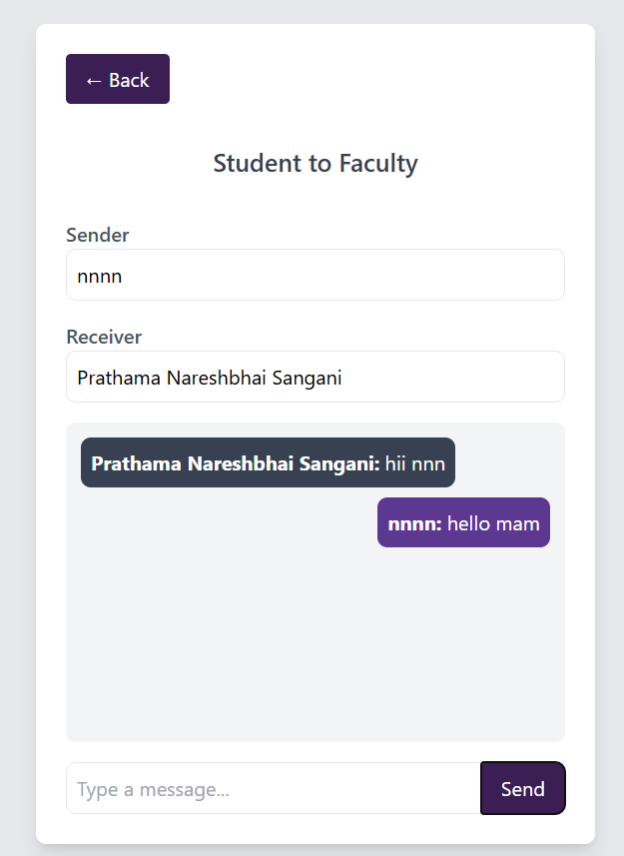
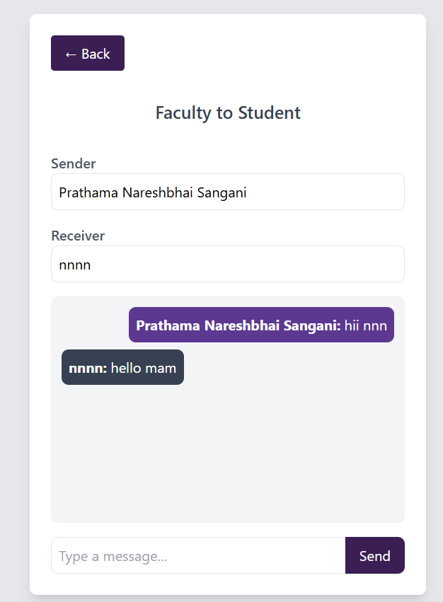
Student page

Slide 14
Limitations
Scalability Constraints: The current system may experience performance degradation under high concurrent user loads and may require auto-scaling solutions.
Limited Payment Gateway Options: Currently, only basic fee payment integration is implemented, limiting support for multiple payment providers.
No Mobile App: The system is web-based, lacking a mobile application for easier student and faculty access.
Lack of AI-driven Automation: The system does not yet integrate AI for automated grading, chatbot assistance, or predictive analytics.

Slide 15
Future Enhancements
AI-based Chatbot: Integrate an AI-powered assistant to help students with common queries and automate responses.
Mobile App Integration: Develop a mobile application for Android and iOS to improve accessibility and user engagement.
Advanced Reporting System: Implement dynamic reports and analytics to track student progress and faculty performance.
Multi-language Support: Enable localization for a diverse user base, allowing users to choose their preferred language.

Slide 16
Conclusion
The Educational Management System streamlines academic administration by automating student records, fee management, and report generation. With role-based access control, it ensures secure and efficient management for Admins, Faculty, and Students. Google Email authentication enhances security, while deployment on Railway ensures accessibility.
My System include JWT authentication, WebSockets-based chat, Razorpay payment integration and microservices architecture for better security, communication, and scalability. These enhancements will make the system more robust, efficient, and adaptable. The SMS continues to evolve, offering a modern, secure, and comprehensive solution for educational institutions.

Slide 17
THANK YOU

